Slide 1
STOR 455 Analysis of Variance Model and Multiple Testing
Read: 5.1 – 5.4
Exercises: 5.27, 37, 38, 40

Slide 2
Quantitative vs. Categorical
We could investigate this relationship several ways:
1. Y = Quantitative; X = Categorical
⇒ “dummy” regression
2. Y = Binary Categorical; X = Quantitative
⇒ logistic regression
3. Difference in two means
⇒ two-sample t-test
4. Difference in more than two means
⇒ ANOVA for means

Slide 3
ANOVA for Difference in K Means
Data: Samples from K different groups
Summary statistics:
For each group
Combine all
Test: H_{o}: μ₁ = μ₂=...= μ_{K}
H_{a}: Some μ_{i} ≠μ_{j}

Slide 4
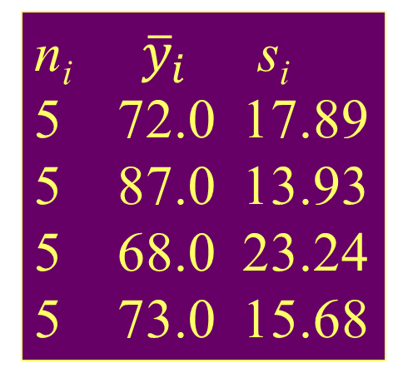
Example: Four Exams
n_{i} ${\overline{y}}_{i}$ s_{i}
5 72.0 17.89
5 87.0 13.93
5 68.0 23.24
5 73.0 15.68
Exam #1:
Exam #2:
Exam #3:
Exam #4:
62, 94, 68, 86, 50
87, 95, 93, 97, 63
74, 86, 82, 70, 28
77, 89, 73, 79, 47
Overall 20 75.0 18.11
Is there a significant difference in average grade among the four exams?
Test: H_{o}: μ₁ = μ₂= μ₃ = μ₄
H_{a}: Some μ_{i} ≠μ_{j}

Slide 5
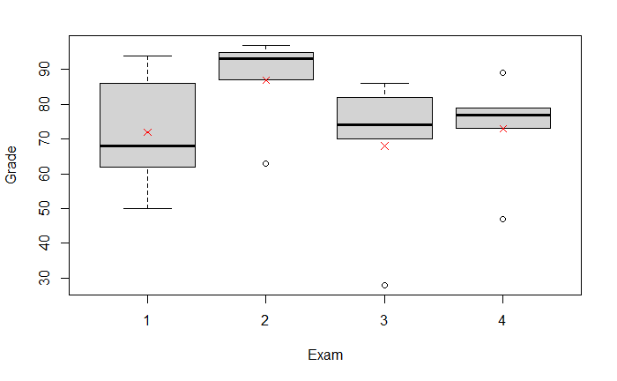
Example: Four Exams
boxplot(Grade~Exam, data=Exams4)
means = tapply(Exams4$Grade, Exams4$Exam,mean)
points(means, col = "red", pch=18)

Slide 6
ANOVA (Means) Model
Mean for Group #i
N(0,σ_{ε}) random error
Under H_{o} (μ_{i}’s all equal) ⇒
(overall mean)
Under H_{a} (μ_{i}’s differ) ⇒
(group mean)

Slide 7
“Predicting” in ANOVA Model
If the group means are the same (H₀):
for all groups ⇒
If the group means can be different (H_{a}):
for i^{th} group ⇒
Do we do “significantly” better with separate means?
Compare sums of squared residuals…
vs.

Slide 8
Partitioning Variability
=
+
Data
Model
Error
Y
=
μ_{i}
+
ε
=
+
TOTAL variation in response, Y
Variation explained by MODEL
Unexplained variation in RESIDUALS
Key question: Does the MODEL explain a “significant” amount of the TOTAL variability?

Slide 9
Partitioning Variability ANOVA for Group Means
Y
=
μ_{k}
+
ε
=
+
?
=
+
=
SSGroups
+
SSE
SSTotal

Slide 10
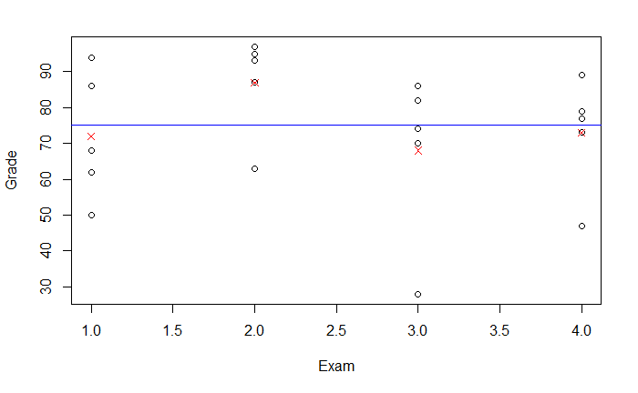
Variation Between vs Within Groups
plot(Grade ~ Exam, data = Exams4)
points(means, col="red", pch=4)
abline(h = mean(Exams4$Grade), col = "blue")

Slide 11
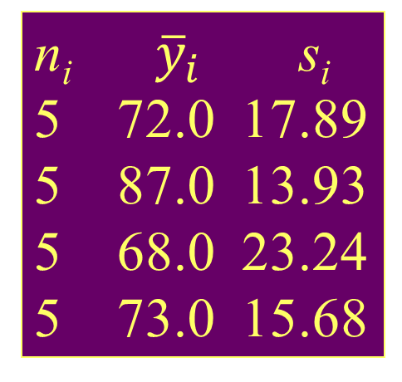
Example: Four Exams
n_{i} ${\overline{y}}_{i}$ s_{i}
5 72.0 17.89
5 87.0 13.93
5 68.0 23.24
5 73.0 15.68
Exam #1:
Exam #2:
Exam #3:
Exam #4:
62, 94, 68, 86, 50
87, 95, 93, 97, 63
74, 86, 82, 70, 28
77, 89, 73, 79, 47
Overall 20 75.0 18.11

Slide 12
ANOVA Table (for K Group Means)
H_{o}: μ₁ = μ₂= … = μ_{K}
H_{a}: Some μ_{i} ≠μ_{j}
Small P-value ➔ Reject H_{o} ➔ There is a significant difference among the means of the K groups

Slide 13
ANOVA Output in R
amodG=aov(Grade~factor(Exam),data=Exams4)
amodG
Call:
aov(formula = Grade ~ factor(Exam), data=Exams4)
Terms:
factor(Exam) Residuals
Sum of Squares 1030 5200
Deg. of Freedom 3 16
Residual standard error: 18.02776
Estimated effects may be unbalanced
summary(amodG)
Df Sum Sq Mean Sq F value Pr(>F)
factor(Exam) 3 1030.0 343.3 1.0564 0.395
Residuals 16 5200.0 325.0

Slide 14
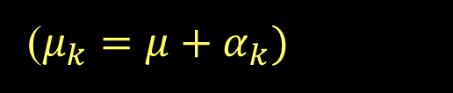
Alternate Form ANOVA Model for Means
Grand Mean
Effect for i^{th} group
Random error
($μ_{k}=μ+α_{k})$
H_{o}: μ₁ = μ₂=...= μ_{K}
H_{a}: Some μ_{i} ≠μ_{j}
⇔
H_{o}: α₁ = α₂=...= α_{K}=0
H_{a}: Some α _{i} ≠0

Slide 15
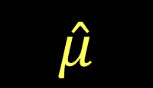
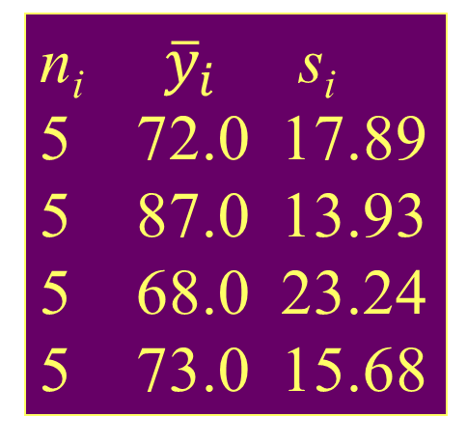
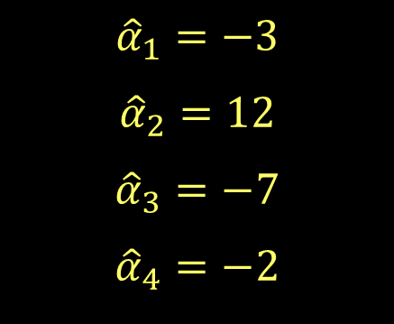
Example: Four Exams
n_{i} ${\overline{y}}_{i}$ s_{i}
5 72.0 17.89
5 87.0 13.93
5 68.0 23.24
5 73.0 15.68
Exam #1:
Exam #2:
Exam #3:
Exam #4:
62, 94, 68, 86, 50
87, 95, 93, 97, 63
74, 86, 82, 70, 28
77, 89, 73, 79, 47
$${\hat{α}}_{1}=−3$$
$${\hat{α}}_{2}=12$$
$${\hat{α}}_{3}=−7$$
$${\hat{α}}_{4}=−2$$
Overall 20 75.0 18.11
$$\hat{μ}$$

Slide 16
Checking Conditions for ANOVA
Check with residuals
Zero mean:
Always holds for sample residuals
Constant variance:
Plot residuals vs. fits and/or compare std. dev.’s of groups (Check if some group s_{i} is more than twice another).
Normality:
Histogram/normal plot of residuals
Independence:
Pay attention to data collection

Slide 17
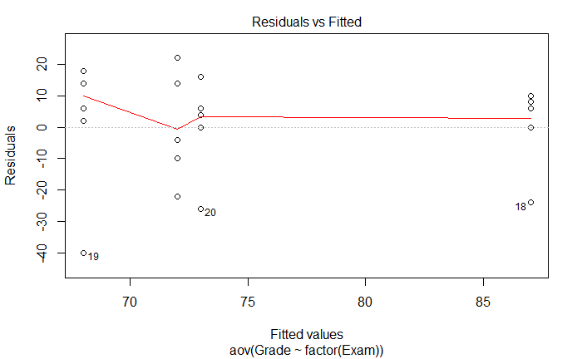
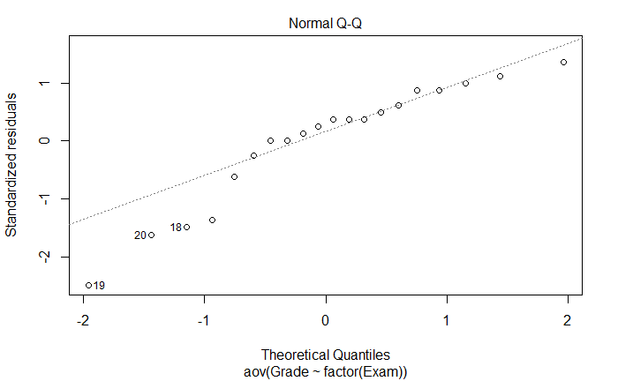
Residual Plots – Exam ANOVA
plot(amodG)
Might be a problem in this tail?

Slide 18
Example: Five Students
Barb Betsy Bill Bob Bud
Exam #1:
Exam #2:
Exam #3:
Exam #4:
62 94 68 86 50
87 95 93 97 63
74 86 82 70 28
77 89 73 79 47
Mean 75.0 91.0 79.0 83.0 47.0
Is there a significant difference in average grade among the five students?

Slide 19
ANOVA for Grades vs. Students
> tapply(Exams4$Grade,Exams4$Student,mean)
Barb Betsy Bill Bob Bud
75 91 79 83 47
> round(tapply(Exams4$Grade,Exams4$Student,sd),2)
Barb Betsy Bill Bob Bud
10.30 4.24 10.98 11.40 14.45
> modS=aov(Grade~factor(Student),data=Exams4)
> summary(modS)
Df Sum Sq Mean Sq F value Pr(>F)
Student 4 4480 1120.0 9.6 0.000468 ***
Residuals 15 1750 116.7
There is a significant difference in mean exam score between the students.
Which means are significantly different?

Slide 20
How Many Comparisons?
Example: Barb, Betsy, Bill, Bob, Bud (5 groups)
Barb vs. Betsy Barb vs. Bill Barb vs. Bob
Barb vs. Bud Betsy vs. Bill Betsy vs. Bob
Betsy vs. Bud Bill vs. Bob Bill vs. Bud
Bob vs. Bud
⇒ 10 possible comparisons

Slide 21
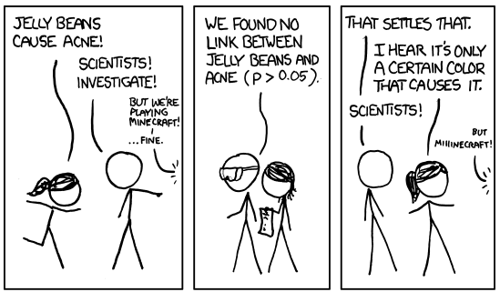
Problem of Multiplicity

Slide 22
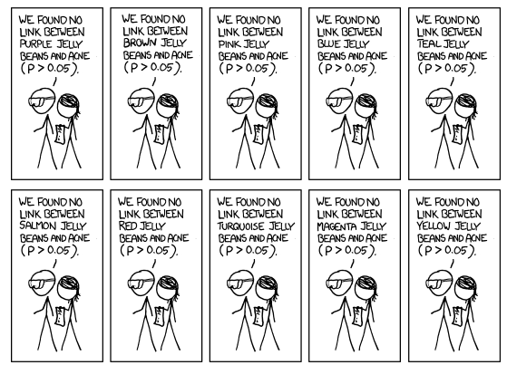
Multiple Testing

Slide 23
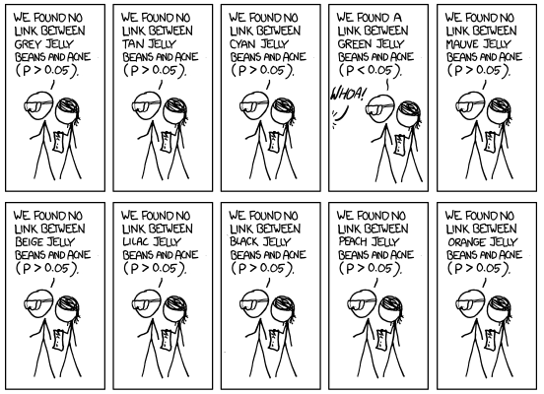
Multiple Testing

Slide 24
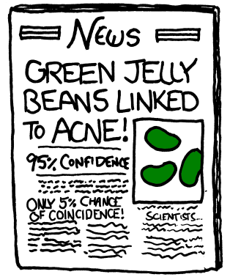
Multiple Testing
http://xkcd.com/882/

Slide 25
Problem of Multiplicity
When doing many pairwise comparisons
⇒ likely to make a Type I error (find a false difference)
In the cartoon, even if there is no relationship between the color and acne, the chance of seeing at least one 0.05 significant test out of 20 independent tests is
1-(1-0.05)^20 =64%!
Possible fixes:
Do only a few pre-planned comparisons
Adjust the significance level used for each test.

Slide 26
Example: Five Students
Barb Betsy Bill Bob Bud
Exam #1:
Exam #2:
Exam #3:
Exam #4:
62 94 68 86 50
87 95 93 97 63
74 86 82 70 28
77 89 73 79 47
Mean 75.0 91.0 79.0 83.0 47.0
Is there a significant difference in average grade among the five students?

Slide 27
ANOVA for Grades vs. Students
> tapply(Exams4$Grade,Exams4$Student,mean)
Barb Betsy Bill Bob Bud
75 91 79 83 47
> round(tapply(Exams4$Grade,Exams4$Student,sd),2)
Barb Betsy Bill Bob Bud
10.30 4.24 10.98 11.40 14.45
> modS=aov(Grade~factor(Student),data=Exams4)
> summary(modS)
Df Sum Sq Mean Sq F value Pr(>F)
Student 4 4480 1120.0 9.6 0.000468 ***
Residuals 15 1750 116.7
There is a significant difference in mean exam score between the students.
Which means are significantly different?

Slide 28
How Many Comparisons?
Example: Barb, Betsy, Bill, Bob, Bud (5 groups)
Barb vs. Betsy Barb vs. Bill Barb vs. Bob
Barb vs. Bud Betsy vs. Bill Betsy vs. Bob
Betsy vs. Bud Bill vs. Bob Bill vs. Bud
Bob vs. Bud
⇒ 10 possible comparisons

Slide 29
Pairwise Comparisons AFTER ANOVA
Compute a CI for μ_{i}− μ_{j}
Pairwise t-tests for difference in means
H_{o}: μ_{i} = μ_{j} vs. H_{a}: μ_{i} ≠ μ_{j}
Use the “usual” procedures except:
(a) Estimate any σ with
(b) Use the error d.f. for any t-values

Slide 30

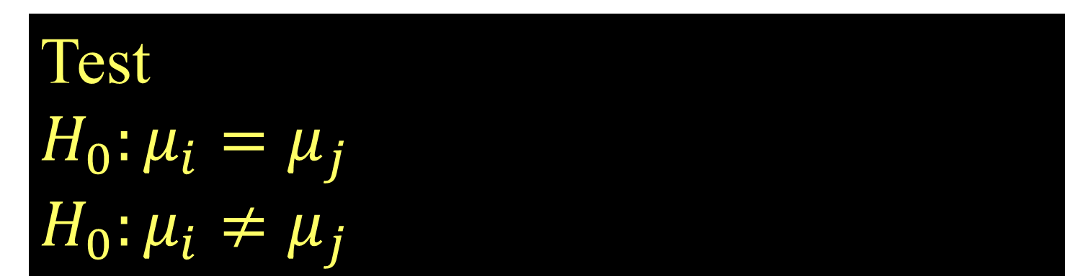
Pairwise Inference After ANOVA
CI for
$$μ_{i}−μ_{j}$$
(use error d.f.)
Test
$$H_{0}:μ_{i}=μ_{j}$$
$$H_{0}:μ_{i}≠μ_{j}$$

Slide 31
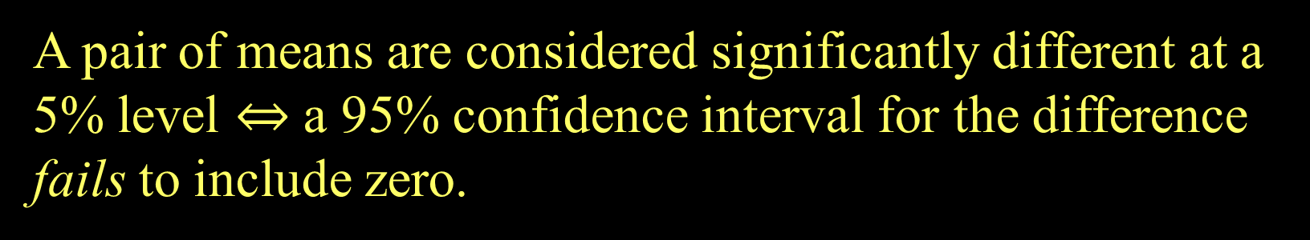
Confidence Intervals and Tests
A pair of means are considered significantly different at a 5% level $⇔$ a 95% confidence interval for the difference fails to include zero.

Slide 32
Fisher’s LSD (Least Significant Difference)
Conclude μ_{i} differs from μ_{j} ⇔

Slide 33

Least Significant Difference
> tapply(Exams4$Grade,Exams4$Student,mean)
Barb Betsy Bill Bob Bud
75 91 79 83 47
> mod2=aov(Grade~Student,data-Exams4)
> summary(mod2)
Df Sum Sq Mean Sq F value Pr(>F)
Student 4 4480 1120.00 9.6 0.0004676 ***
Residuals 15 1750 116.67
Bud’s mean grade is sig. different from the other four.
There is a significant difference in mean exam score between the students.
$$LSD=2.132\sqrt{116.67}\sqrt{\frac{1}{4}+\frac{1}{4}}=16.3$$

Slide 34
Problem of Multiplicity
When doing many pairwise comparisons ⇒ likely to make a Type I error (find a false difference)
⇒ Fisher’s LSD may be too lenient (liberal)
Possible fixes:
Do only a few pre-planned comparisons
Use a smaller α for each test.
Bonferroni adjustment: When doing m tests with a overall error rate of α*, use α ≈ α*/m for each test.

Slide 35
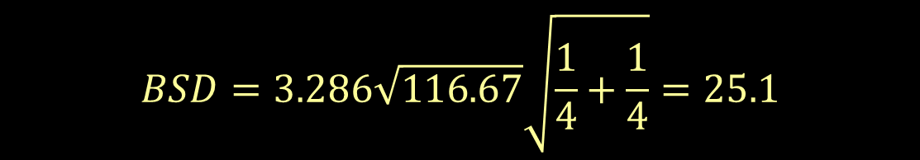
Bonferroni Significant Difference
> tapply(Exams4$Grade,Exams4$Student,mean)
Barb Betsy Bill Bob Bud
75 91 79 83 47
> mod2=aov(Grade~Student,data-Exams4)
> summary(mod2)
Df Sum Sq Mean Sq F value Pr(>F)
Student 4 4480 1120.00 9.6 0.0004676 ***
Residuals 15 1750 116.67
Bud’s mean grade is sig. different from the other four.
10 comparisons ⇒ use $α=\frac{0.05}{10}=0.005$ for each test
$$BSD=3.286\sqrt{116.67}\sqrt{\frac{1}{4}+\frac{1}{4}}=25.1$$
t* for 99.5%

Slide 36
Tukey’s HSD (Honestly Significant Difference)
Replace t* with a value q* from the studentized range distribution (use R).
Depends on α, # groups=K, and error d.f.
R: use qtukey(1-α, K, n-K)

Slide 37
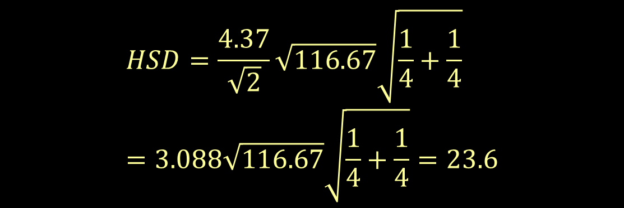
ANOVA for Grades vs. Students
> tapply(Exams4$Grade,Exams4$Student,mean)
Barb Betsy Bill Bob Bud
75 91 79 83 47
> mod2=aov(Grade~Student,data-Exams4)
> summary(mod2)
Df Sum Sq Mean Sq F value Pr(>F)
Student 4 4480 1120.00 9.6 0.0004676 ***
Residuals 15 1750 116.67
> qtukey(1-0.05,5,15)
4.366985
Bud’s mean grade is sig. different from the other four.
$$HSD=\frac{4.37}{\sqrt{2}}\sqrt{116.67}\sqrt{\frac{1}{4}+\frac{1}{4}}=3.088\sqrt{116.67}\sqrt{\frac{1}{4}+\frac{1}{4}}=23.6$$

Slide 38
LSD and BSD in R
#To get pairwise tests using Fisher's LSD
> pairwise.t.test(Exams4$Grade,Exams4$Student,p.adj="none")
Barb Betsy Bill Bob
Betsy 0.05357 - - -
Bill 0.60812 0.13699 - -
Bob 0.31148 0.31148 0.60812 -
Bud 0.00229 3.8e-05 0.00079 0.00028
P value adjustment method: none
#To get pairwise tests using Bonferroni
> pairwise.t.test(Exams4$Grade,Exams4$Student,p.adj="bonf")
Barb Betsy Bill Bob
Betsy 0.53567 - - -
Bill 1.00000 1.00000 - -
Bob 1.00000 1.00000 1.00000 -
Bud 0.02293 0.00038 0.00789 0.00277
P value adjustment method: bonferroni
Small p-value ⇒ different group means

Slide 39
Tukey HSD via R
> TukeyHSD(modS)
Tukey multiple comparisons of means
95% family-wise confidence level
Fit: aov(formula = Grade ~ Student)
$Student
diff lwr upr p adj
Betsy-Barb 16 -7.584413 39.584413 0.2720310
Bill-Barb 4 -19.584413 27.584413 0.9835150
Bob-Barb 8 -15.584413 31.584413 0.8295529
Bud-Barb -28 -51.584413 -4.415587 0.0166293
Bill-Betsy -12 -35.584413 11.584413 0.5360462
Bob-Betsy -8 -31.584413 15.584413 0.8295529
Bud-Betsy -44 -67.584413 -20.415587 0.0003116
Bob-Bill 4 -19.584413 27.584413 0.9835150
Bud-Bill -32 -55.584413 -8.415587 0.0060225
Bud-Bob -36 -59.584413 -12.415587 0.0021941

Slide 40
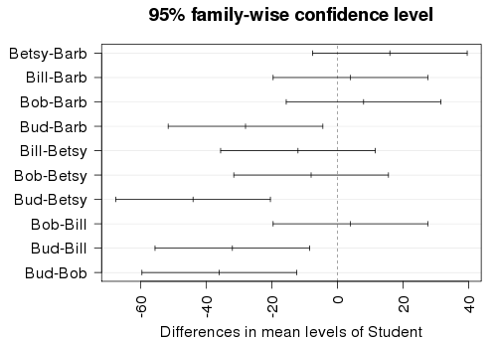
origpar=par() #saves current graphic parameters par(mar=c(4,7,3,1)) #adjusts margins for wider labels hsd=TukeyHSD(modS) #save the Tukey intervals plot(hsd,las=2) #plot the intervals
par(origpar) #restore graph settings

